Slide 1
Cross The River
Presenter :
1. Ali Akbar Talukdar ID : 011143001
2. Rubait Bin Hasan ID : 011143025

Slide 2
Introduction : Our project “Cross the River” contains a game where some objects needs to be passed from one side to another.A boat can carry maximum two objects.If No of Red objects increase,the game will end.The game will continue based on No of Green Objects > No of Red objects.

Slide 3
Indivisual Task
Rubait Bin Hasan : Necessary Rectangle creation
Ali Akbar Talukdar : Object movement & maintaining conditional requiremens

Slide 4
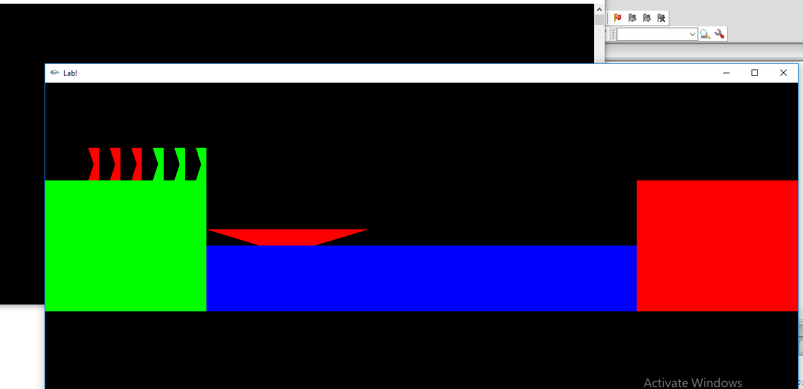
Screenshot of Project

Slide 5
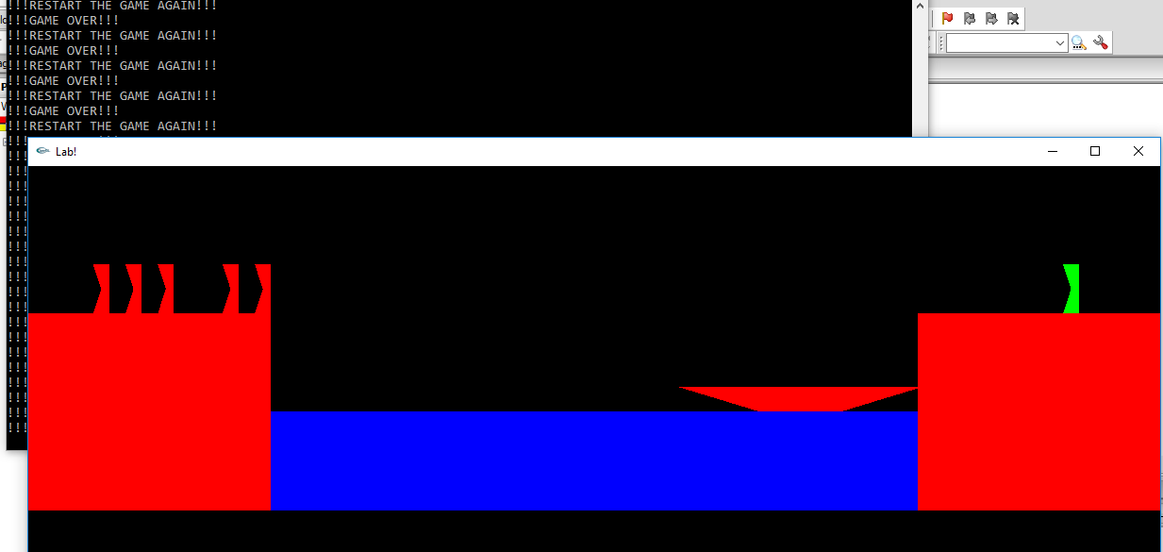
Screensot of Project

Slide 6
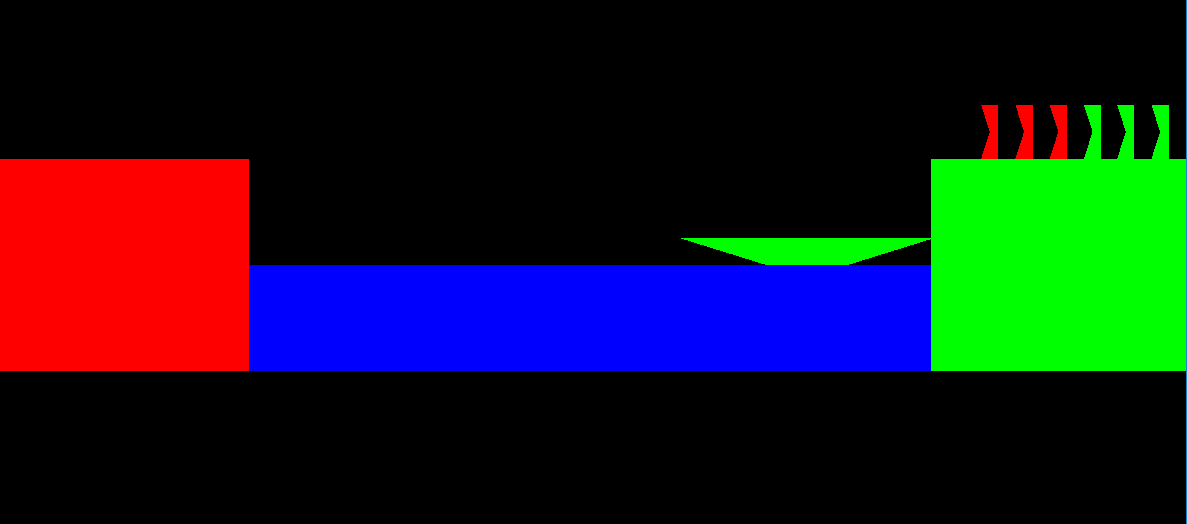
Screenshot of Project

Slide 7
Thank You

